Slide 1

3D MAPPING

Slide 2
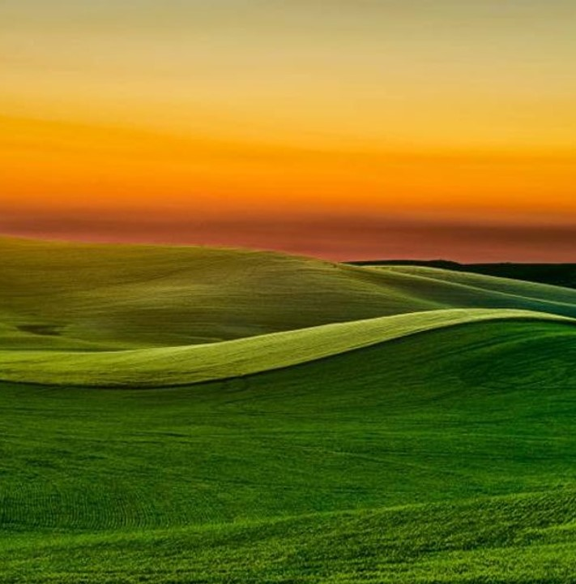
3D mapping
Slide 3 & 4 - 3D visual reconstruction
Slide 5 & 6 – 3D Software
Slide 7 & 8 – 3D Modeling/GIS
Slide 9 & 10 – Rendering software & 3D mapping platforms

Slide 3
3D visual reconstruction: the process of creating three-dimensions
3D visual reconstruction can be defined as a process of creating three-dimensional models of objects or scenes from two-dimensional images or video footage.
There are five different components that make up the process of creating a 3D image.
Those five components are:
Image Acquisition
Feature Extraction
Correspondence Estimation
Reconstruction
Surface Reconstruction

Slide 4
3D visual reconstruction: the process of creating three-dimensions
Image Acquisition - Capturing images or videos of the object or scene from different viewpoints.
Feature Extraction - Key features or points in the images are identified. These features could be corners, edges, or distinctive patterns that can be reliably tracked across multiple images.
Correspondence Estimation – 3D Software tries to establish correspondence between these features across different images. (example: features in one image correspond to the same point or feature in another image.)
Reconstruction - Using the correspondence established, the software calculates the 3D position of the points in space relative to the camera positions, OR TRIANGULATION, using 3D coordinates of a point by intersecting lines of sight from multiple camera viewpoints.
Surface Reconstruction – 3D software constructs a surface mesh or volume representing the object or scene based on the 3D point cloud generated in the previous step. This surface can be further refined or smoothed to improve its quality.

Slide 5
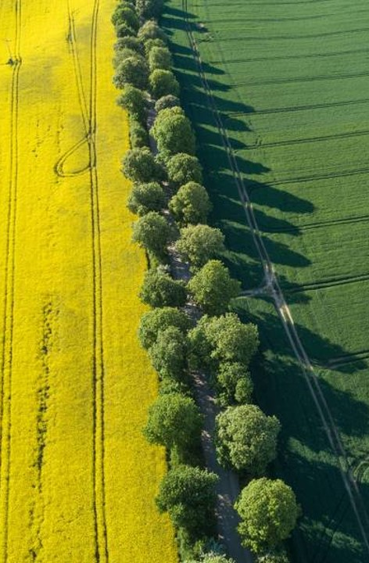
3D visual reconstruction Software
Structure-from-Motion (SfM) Software
Multi-View Stereo (MVS) Software
Point Cloud Processing Software
Computer Vision Libraries

Slide 6
3D visual reconstruction Software
Structure-from-Motion (SfM) Software - These software packages, such as COLMAP, VisualSFM, and Bundler, are used for feature extraction, correspondence estimation, and initial 3D reconstruction from images.
Multi-View Stereo (MVS) Software - Meshroom, openMVS, and AliceVision, takes the initial sparse reconstruction from SfM and generates a dense 3D point cloud or mesh.
Point Cloud Processing Software - Tools like CloudCompare, MeshLab, and PDAL are used for processing and refining the dense point clouds generated by SfM and MVS software. They offer functionalities such as filtering, meshing, and texturing.
Computer Vision Libraries - Libraries like OpenCV and PCL (Point Cloud Library) provide various computer vision algorithms and functionalities that are often used in conjunction with specialized reconstruction software.

Slide 7

3D Modeling Software
Blender: Blender is a powerful open-source 3D modeling and animation software that can be used to create detailed 3D models of landscapes, buildings, and other objects.
Autodesk Maya: Maya is a professional 3D modeling and animation software widely used in the industry. It offers advanced tools for modeling, texturing, and rendering.
SketchUp: SketchUp is a user-friendly 3D modeling software that is popular for architectural design and urban planning. It's relatively easy to learn and suitable for creating simple 3D models.

Slide 8
GIS Software
GEOGRAPHIC INFORMATION SYSTEMS:
ArcGIS Pro: ArcGIS Pro is a comprehensive GIS (Geographic Information System) software developed by Esri. It allows users to work with spatial data, create maps, and perform spatial analysis.
QGIS: QGIS is an open-source GIS software that provides similar functionalities to ArcGIS. It's free to use and widely used by professionals and researchers.

Slide 9
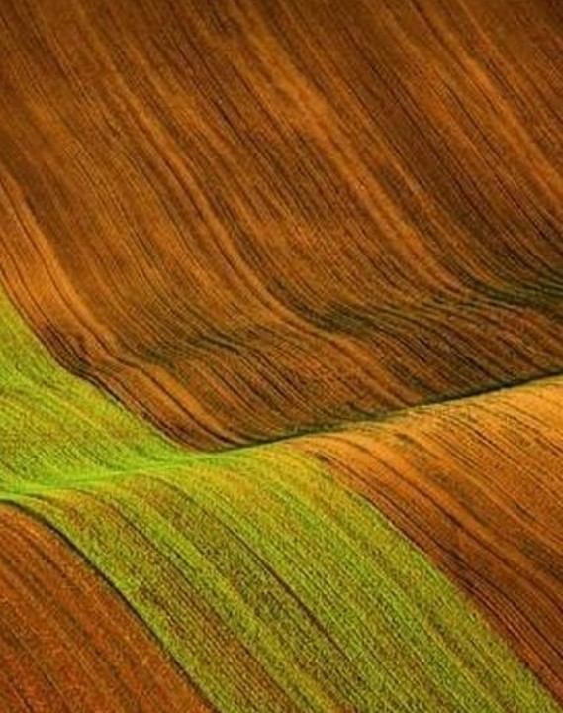
3D Visualization and Rendering Software:
Unity: Unity is a popular game engine that can be used to create interactive 3D maps with real-time rendering. It provides tools for importing 3D models, adding interactivity, and optimizing performance.
Unreal Engine: Unreal Engine is another game engine known for its high-fidelity graphics and visual effects. It can be used to create immersive 3D environments for interactive maps.
Three.js: Three.js is a JavaScript library for creating 3D graphics on the web. It's often used to build web-based interactive 3D maps that can be viewed in a web browser.

Slide 10

Web Mapping Platforms
Mapbox:
Mapbox provides tools and APIs for creating custom maps and integrating them into web and mobile applications. It offers 3D mapping capabilities and supports interactivity.
Google Maps Platform:
Google Maps Platform offers APIs for embedding interactive maps into web and mobile applications. While primarily 2D, it does support some basic 3D features.

Slide 11

Thank you
​The International Society for Technology in Education (ISTE) standards can be aligned with STEM in developing your unit and lesson plans. The link to the ISTE Standards can be found at www.alex-foundationasenseofplace.org.

